Slide 1
Will you burnout if you are gritty but don’t love what you do?
Preliminary data
Running studies
Future directions

Slide 2
What is Self-Determination Theory?
Basic Psychological Needs
Autonomy
Competence
Relatedness
Motivational Continuum
Extrinsic
Intrinsic

Slide 3
What is Self-Determination Theory?
Basic Psychological Needs
Autonomy
Competence
Relatedness
Motivational Continuum
Extrinsic
Introjected
Identified
Intrinsic
External

Slide 4
What is Self-Determination Theory?
Basic Psychological Needs
Autonomy
Competence
Relatedness
Motivational Continuum
Controlled
Autonomous
Less autonomy
Effortful
Aversive
Superficial Learning
Cheating
More Autonomy
Effortless
Pleasant
Deep Learning
Helping

Slide 5
What is Self-Determination Theory?
Basic Psychological Needs
Autonomy
Competence
Relatedness
Motivational Continuum
Controlled
-
Autonomous
We will call this difference score self-concordance for simplicity
Self Concordance Score: specific goals
Relative Autonomy Index: specific domain

Slide 6
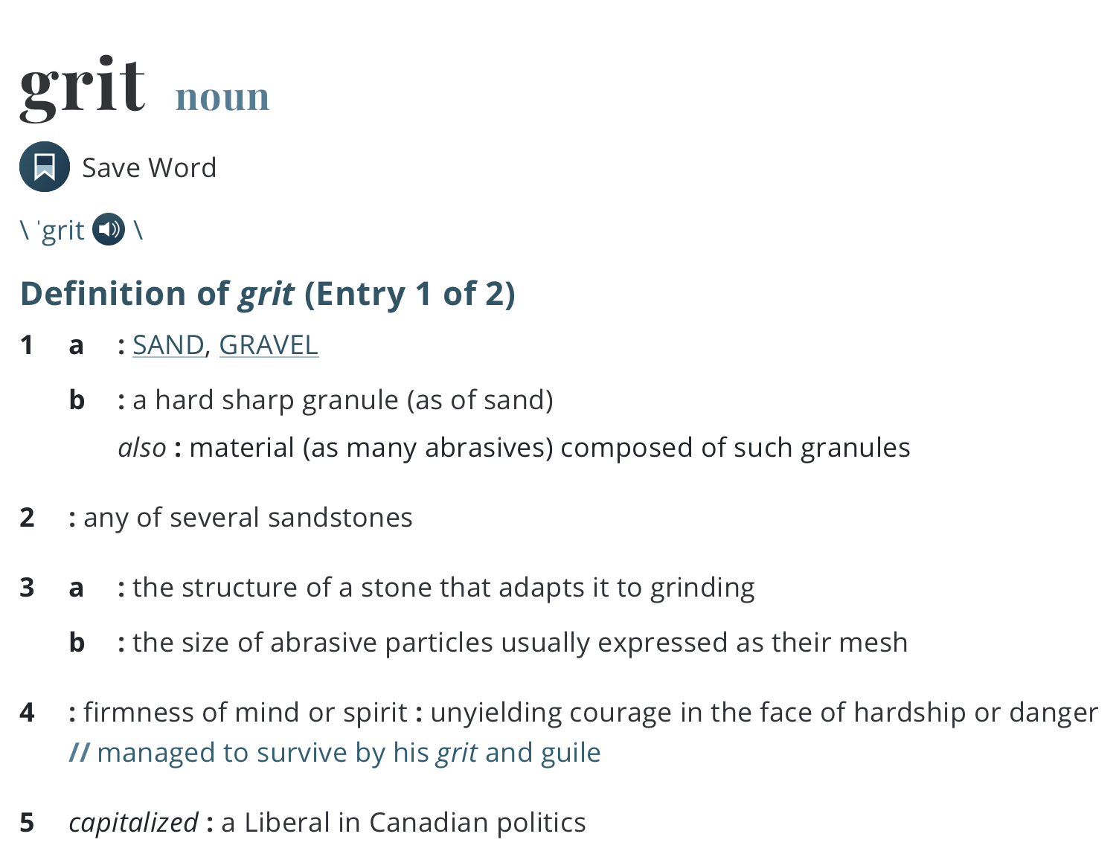

Slide 7
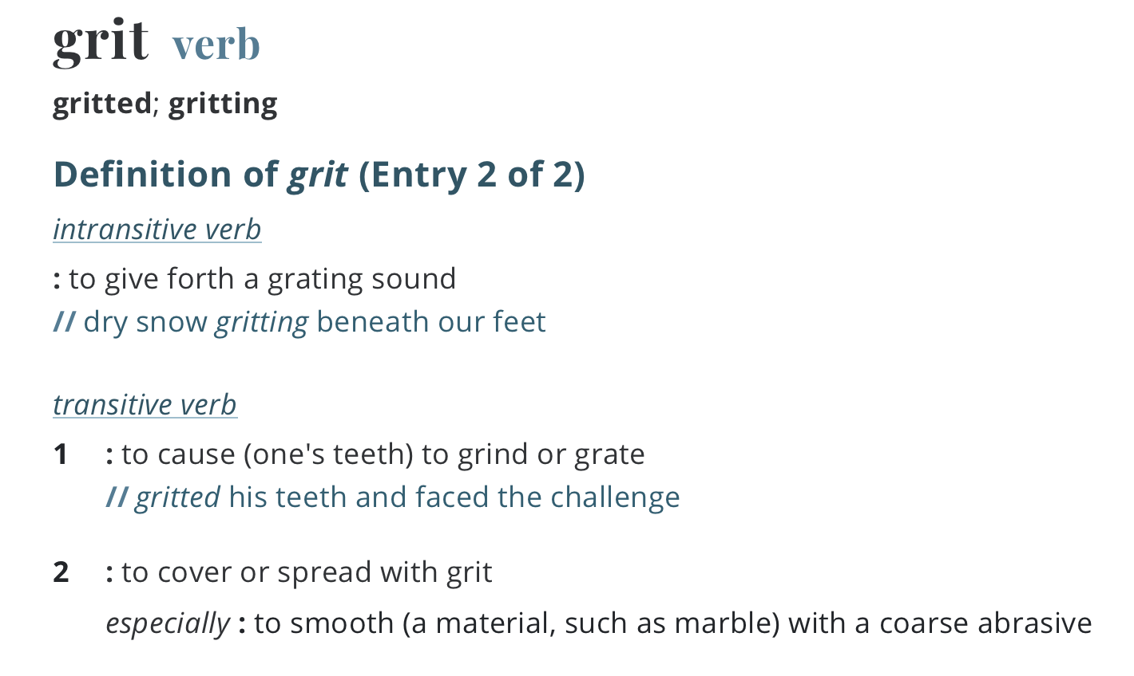

Slide 8
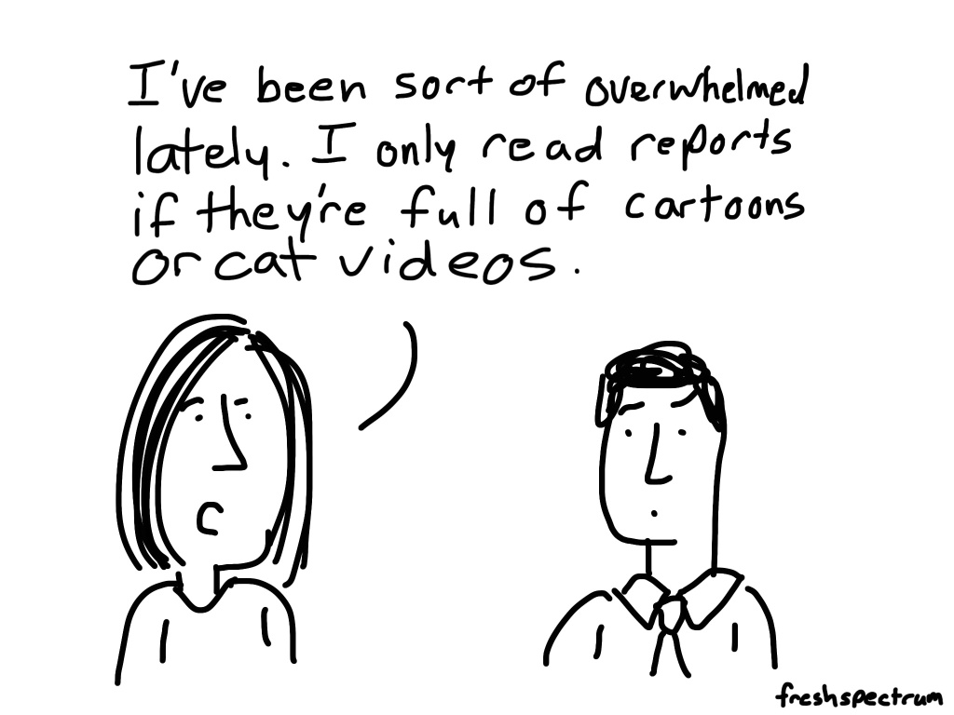



Slide 9
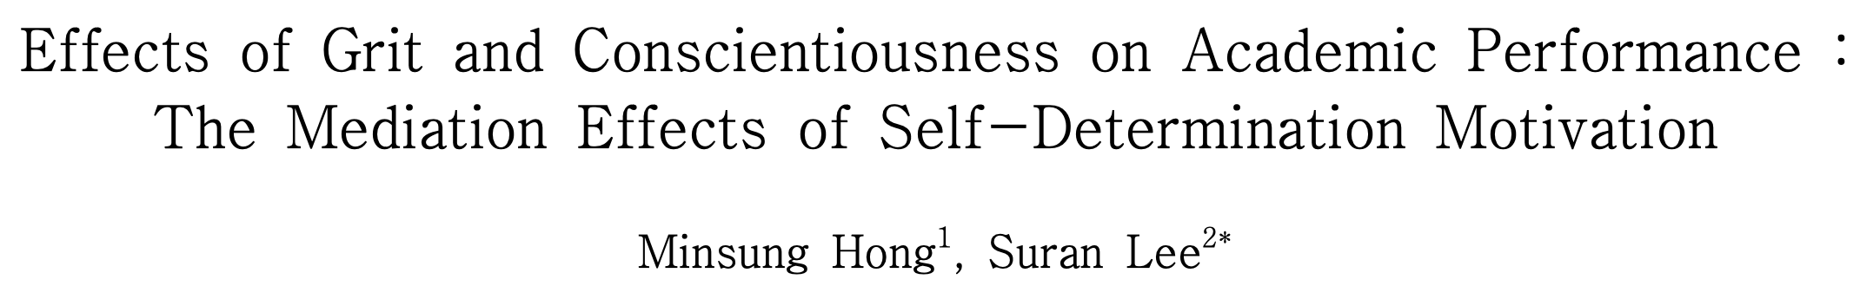
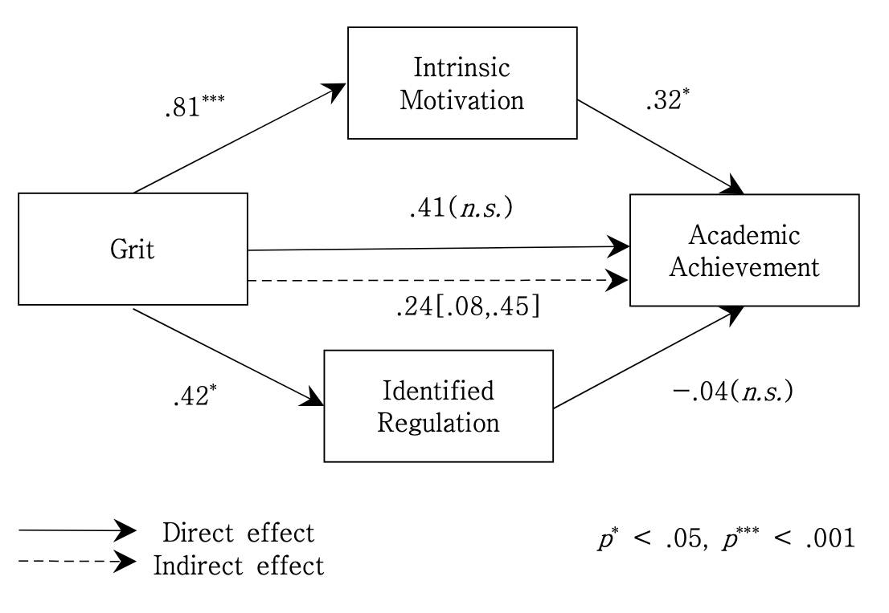
How does grit relates to motivation quality?
Notes:
https://www.koreascience.or.kr/article/JAKO201931663568156.pdf

Slide 10
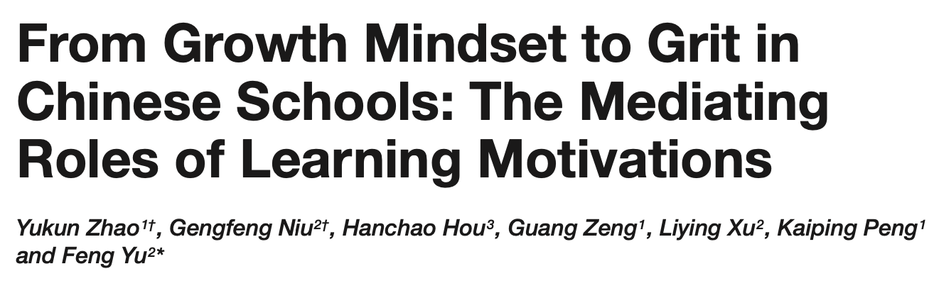
Notes:
https://www.frontiersin.org/articles/10.3389/fpsyg.2018.02007/full

Slide 11
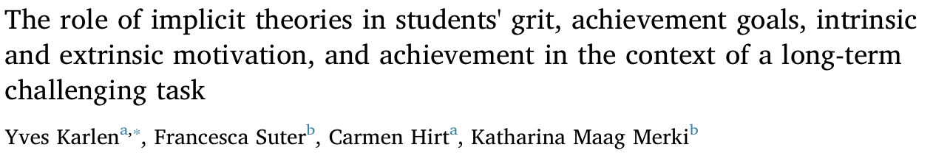
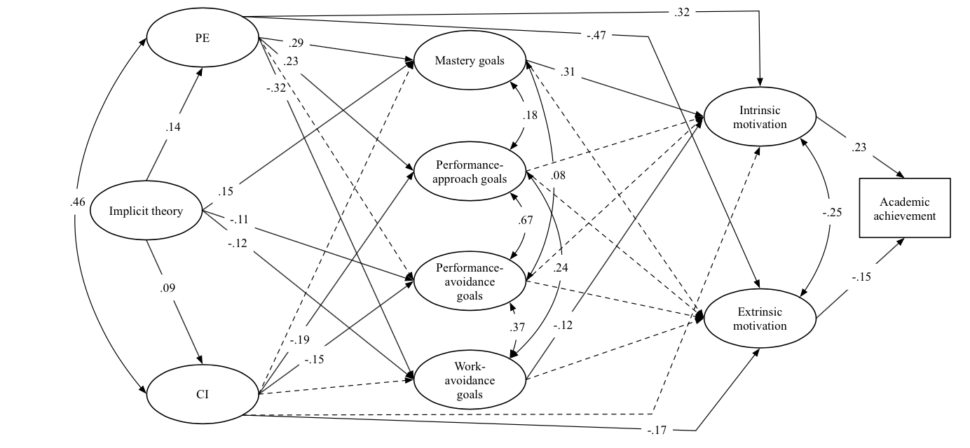
Notes:
https://reader.elsevier.com/reader/sd/pii/S1041608019300937?token=6D570120CDF0F175020BD75843A513E5A7BD6DEC3C167A93841FEFC5BD2BA12565037CFF623300CFDA851D43D97D4B3E

Slide 12
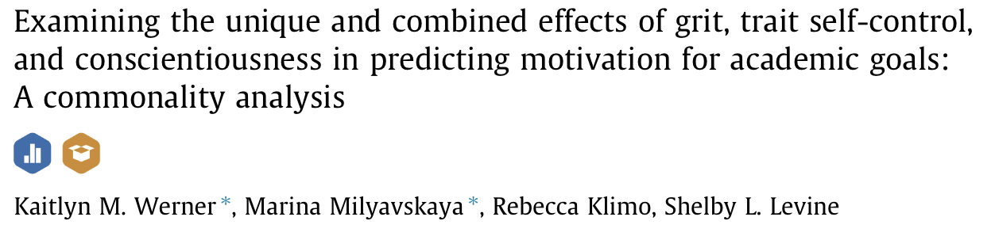
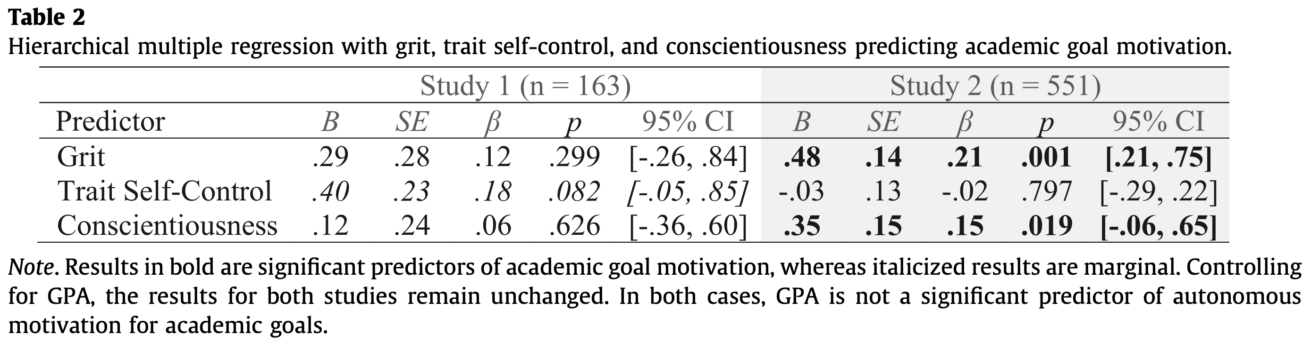
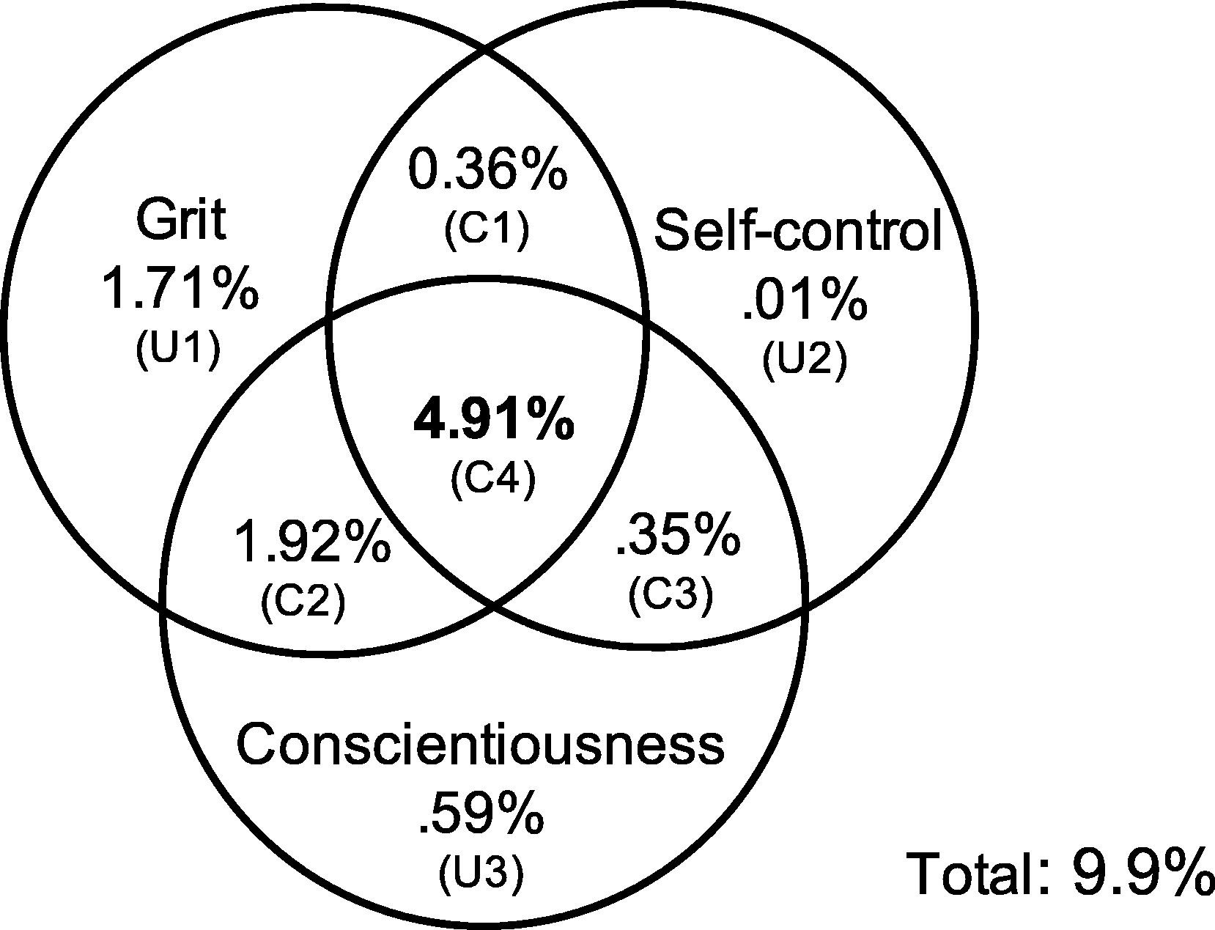
8.9% Variance Explained
r = .30

Slide 13
Preliminary data
Grit 12, Self-concordance of 3 goals
198 MTurkers
mean age = 38.7
age range = 23 to 73
53% female
r = .40***
*I lied, we did collect some data that could be treated as DVs, we can discuss at the end
Notes:
Passion in red
Perseverance in blue

Slide 14
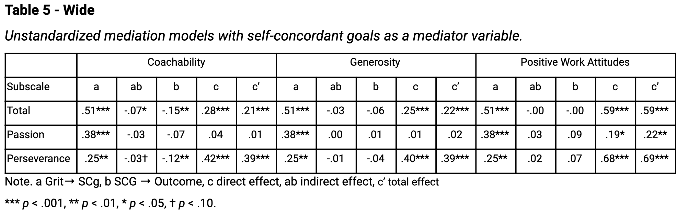
Pseudo-DVs
 |  | Coachability |  |  |  | Generosity |  |  |  | Positive Work Attitudes
Measure | Subscale | C | G | I | S | C | G | I | S | C | G | I | S
Grit-12 | Passion | 3.75*** | .04 | .12* | -.10† | 3.95*** | .02 | .03 | .00 | 3.90*** | .20* | .18* | .05
Grit-12 | Perseverance | 3.79*** | .42*** | .02 | -.12** | 3.97*** | .40*** | -.06 | -.03 | 3.96*** | .68*** | .08 | .06
Grit-12 | Total | 3.77*** | .27*** | .07 | -.15** | 3.97*** | .26*** | -.04 | -.05 | 3.94*** | .57*** | .11 | -.02
Note. C Constant, G Grit, I Interaction term, S Self-concordant goals
*** p < .001, ** p < .01, * p < .05, † p < .10.

Slide 15






Adding an outcome
After discussing well-being and goal attainment, as possible DVs, we settled on Burnout
Self-concordance
Burnout
Grit

Slide 16






Burnout
Low self concordance
High self concordance
Grit

Slide 17

Take the survey! (2-3 mins)
https://tinyurl.com/PreviewGritSDT
Not case sensitive
Notes:
https://upenn.co1.qualtrics.com/jfe/preview/SV_4SLrRzTHCPWpst7?Q_CHL=preview&Q_SurveyVersionID=current

Slide 18
Pilot data
Grit 12
Relative Autonomy for your Job
Emotional Exhaustion
100 Prolific-ers
Mean age = 34.28
Age range = 22 to 54
24% female
r = .51***
r = .50*** and .34***
Self concordance
Notes:
Passion in red
Perseverance in blue

Slide 19
Reliability and Distributions

Slide 21
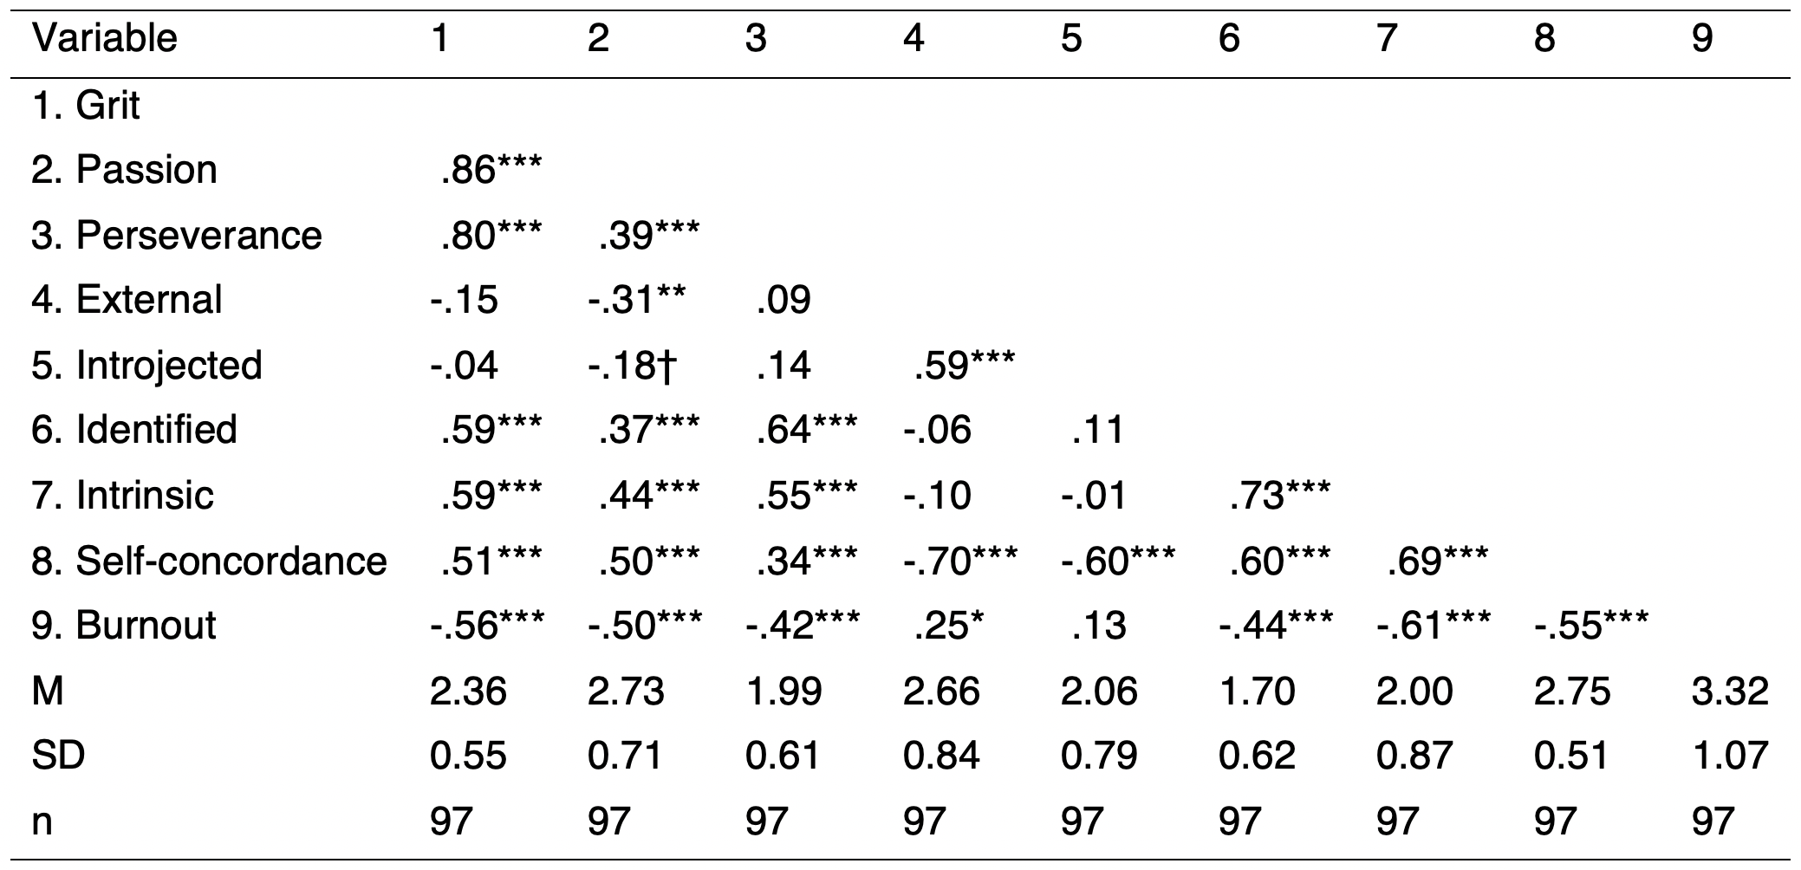
Pilot data
Grit 12
Relative Autonomy for your Job
Emotional Exhaustion
100 Prolific-ers
Mean age = 34.28
Age range = 22 to 54
24% female
Notes:
Variables of interest

Slide 22
Pilot data
Grit 12
Relative Autonomy for your Job
Emotional Exhaustion
100 Prolific-ers
Mean age = 34.28
Age range = 22 to 54
24% female
Notes:
Variables of interest

Slide 23
Pilot data
Grit 12
Relative Autonomy for your Job
Emotional Exhaustion
100 Prolific-ers
Mean age = 38.7
Age range = 23 to 73
53% female
Notes:
Our control variables are unrelated to outcome and predictors

Slide 24
Pilot data
Grit 12
Relative Autonomy for your Job
Emotional Exhaustion
100 Prolific-ers
Mean age = 38.7
Age range = 23 to 73
53% female

Slide 25
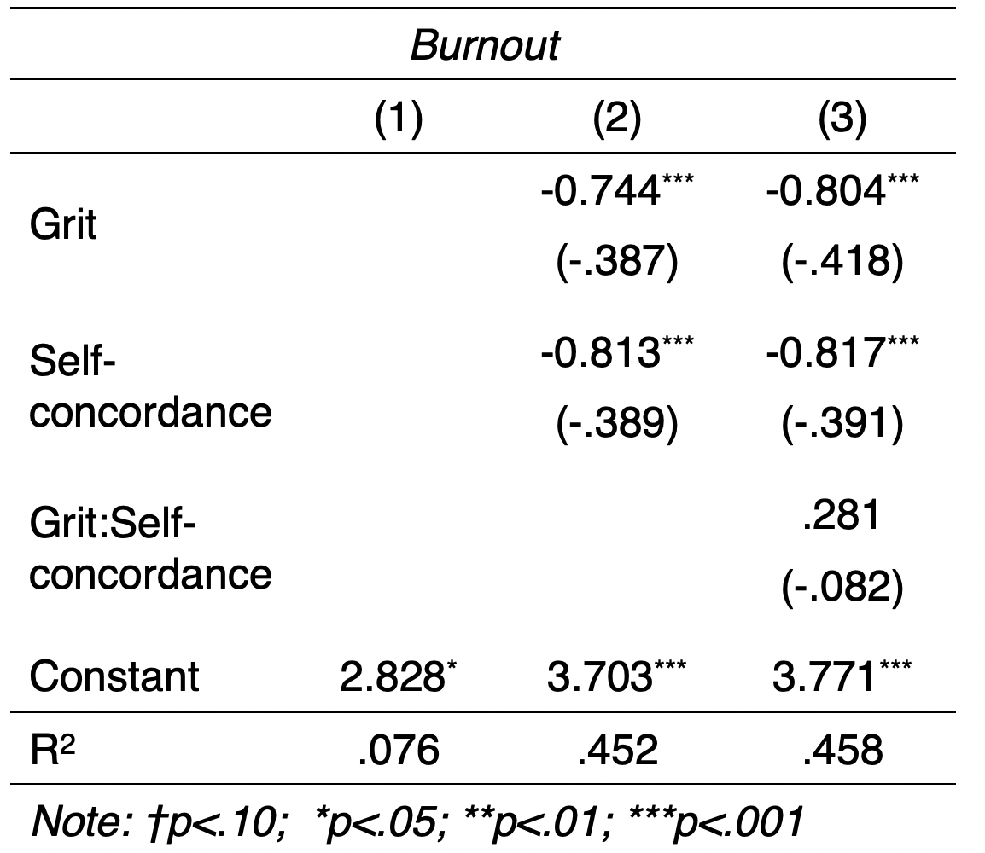
Pilot data
Model Comparison
F = 0.91, p = .344
Controlling for age, sex, pay, and work hours
*Models without controls are available.

Slide 26
Models by facets
Here is an interactive document with models by all possible combinations of facets.

Slide 27
Pilot data
Model Comparison
F = 0.20, p = .653
Notes:
.38 Grit
.36 RAI
.04 Interaction

Slide 28
Discussion
Why wouldn’t there be an interaction
Restriction on range? Cluster analysis creates no group defined by high grit, low self-concordance.

Slide 29
Discussion
Why wouldn’t there be an interaction
Restriction on range? Cluster analysis creates no group defined by high grit, low self-concordance.

Slide 30
Discussion
Why wouldn’t there be an interaction
Restriction on range? Cluster analysis creates no group defined by high grit, low self-concordance.

Slide 31
Discussion
Why wouldn’t there be an interaction
Restriction on range? Cluster analysis creates no group defined by high grit, low self-concordance.

Slide 32
Discussion
Why wouldn’t there be an interaction
Restriction on range? Cluster analysis creates no group defined by high grit, low self-concordance.

Slide 33
Discussion
Why wouldn’t there be an interaction
Restriction on range? Cluster analysis creates no group defined by high grit, low self-concordance.

Slide 34
Discussion
Why wouldn’t there be an interaction
Restriction on range? Cluster analysis creates no group defined by high grit, low self-concordance.

Slide 35
Discussion
Why wouldn’t there be an interaction
Would it make more sense to analyze this as a mediation?
Self-concordance
-.36***
.51***
Indirect effect = -.18***
Proportion mediated = .33***
Grit
Burnout
-.37***
Total effect = -.56***

Slide 36
Discussion
Why wouldn’t there be an interaction
Would it make more sense to analyze this as a mediation?
Grit
-.37***
.51***
Indirect effect = -.19***
Proportion mediated = .34***
Self-concordance
Burnout
-.36***
Total effect = -.55***

Slide 37
Discussion
Why wouldn’t there be an interaction
Would it make more sense to analyze this as a mediation?
Demand effects might be inflating the relationship between variables?

Slide 38
Discussion
Why wouldn’t there be an interaction
Would it make more sense to analyze this as a mediation?
Demand effects might be inflating the relationship between variables?
Burnout is more related to the quantity rather than the quality of motivation
Controlled motivation only lasts while the reinforcers are present
Autonomous motivation is self-sustaining

Slide 39
Discussion
Why wouldn’t there be an interaction
Would it make more sense to analyze this as a mediation?
Demand effects might be inflating the relationship between variables?
Burnout is more related to the quantity rather than the quality of motivation
Burnout requires time
We didn’t ask a crucial question
“How long have you been in your job”

Slide 40
Next Steps Dropout and burnout in Chinese-American Weekend Schools
Maybe the interaction occurs at higher levels of exertion
Reference bias may be inflating grit scores
Chinese weekend schools (George Lin)
Students work on weekends to get into top schools in certain prestigious professions
Expected high levels of grit, more unrelated to motivation quality
Possible limitations: self-awareness and desirability bias

Slide 41
Next Steps Dropout and burnout in chinese schools
Grit
Grit
Grit
Career Self-Concordance
Career Self-Concordance
Career Self-Concordance
Burnout
Burnout
Burnout
Dropout
Dropout
Dropout
Survival analysis?
Latent growth models?

Slide 42
Next Steps Longitudinal objective outcomes
T1
T2
Academic Achievement
Academic Achievement
Well-Being
Well-Being
Grit
Self-Concordance of academic goals
Grit X Self-Concordance

Slide 43
Other ways to link grit and self-determination theory Grit might affect self-concordance change
We learn to love that in which we get good at
Effort X Ability
Self-Concordance
T1
Self-Concordance
T2
Effort
Ability
This is contrary to the original burnout idea
Moderated by a “everything can be interesting” mindset?

Slide 44
Other ways to link grit and self-determination theory Intrapersonal variability
Usual self-concordance research aggregates data at the individual level
Within- level variance might be interesting!
We might behave differently for different goals
What about state grit?

Slide 45
Other ways to link grit and self-determination theory Introjection might block the development of grit
Innate interests and talents
Explore and try
Decision to develop or drop interest
Emotions as internal signals and feedback
Passion attainment
Attention to these signals might be blocked by introjection
Similar to Westgate (2020), Kurzban et al., (2013)

Slide 46



Other ways to link grit and self-determination theory Two ways in which things can be effortful
That was hard coach,
Not fun at all!
But was it satisfying?

Slide 47
Take home messages
Grit might have connotations of controlled motivation but is associated with autonomous motivation and self-concordance.

Slide 48
Take home messages
Grit might have connotations of controlled motivation but is associated with autonomous motivation and self-concordance.
In a pilot sample of Prolific-ers, both grit and self-concordance have protective effects against burnout

Slide 49
Take home messages
Grit might have connotations of controlled motivation but is associated with autonomous motivation and self-concordance.
In a pilot sample of Prolific-ers, both grit and self-concordance have protective effects against burnout; but do not interact in predicting it. Mediation might be a more suitable way to make sense of this data.

Slide 50
Take home messages
Grit might have connotations of controlled motivation but is associated with autonomous motivation and self-concordance.
In a pilot sample of Prolific-ers, both grit and self-concordance have protective effects against burnout; but do not interact in predicting it. Mediation might be a more suitable way to make sense of this data.
Longitudinal designs and more specific samples might be necessary to elaborate this idea further.

Slide 51
Take home messages
Grit might have connotations of controlled motivation but is associated with autonomous motivation and self-concordance.
In a pilot sample of Prolific-ers, both grit and self-concordance have protective effects against burnout; but do not interact in predicting it. Mediation might be a more suitable way to make sense of this data.
Longitudinal designs and more specific samples might be necessary to elaborate this idea further.
There are different possible ways to interface grit and self-determination theory research.

